Slide 1
Capstone Time Series Project
“Time Series / Forecasts:
From the basic solution to the complex
– daily and monthly
- by store and by product.”
by Alex Dance

Slide 2

Agenda
Exploratory data analysis
The business problem
The approach
The results
Next steps

Slide 3

EXPLORATORY DATA ANALYSIS

Slide 4
Time Series Problem: Have a data set of 5 years of retail sales (917K rows)
by day
by product (50 products)
by store (10 stores)
totaling over 10M sales p/a
at $50 a sale = $500M sales per annum
Goal: Do a better job of forecasting future sales -> Improve Profitability

Slide 5
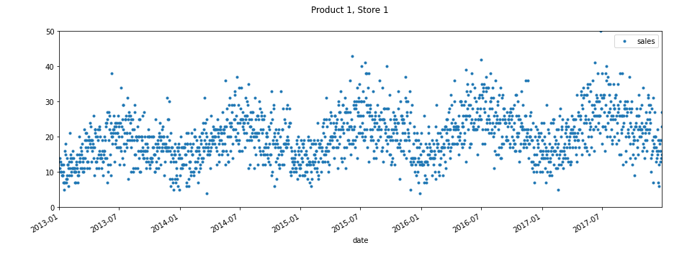
A quick look at the data highlights annual increases and seasonal trends
Outliers
Annual Increases
Seasonal Trends
Trained on 4 years of data
Forecasted and measured on 1 year of data

Slide 6
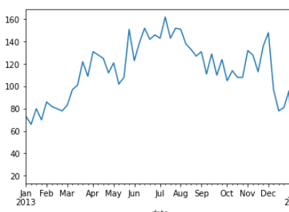
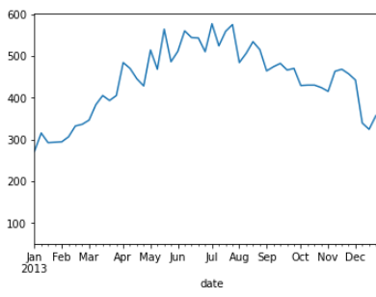
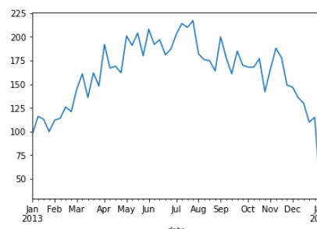
Adding to the complexity there is variability between stores and items
Item 1 Store 1
Item 1 Store 2
Hardest to do/ best forecast
IS
by store
by product
By day
Different products have different patterns across stores
Item 2 Store 1
10 stores + 50 products = 500 forecasts
by day over a year = 182,500 values
Stores don’t have the same patterns for all products

Slide 7

BUSINESS PROBLEM

Slide 8
A better forecast will lead to improved profitability PLUS a better customer experience
Issue | Details | Assumptions | Annual Benefit
Customer Need | Customers can’t find products they want | 7% increase when would have been a lost sale (4% of the time) | $1.4M
Use of space | Better use of store floor space Better use of warehouse space | 3% less spend on rent | $1.5M
Organisation Level | Better demand Planning | 1% reduced staff costs | $750K
Discounting | Less stock clearance sales | 15% less discounting | $1.25M
Not Sold | Less Waste | 25% less throw away stock | $2.5M
$7.4M
Based on a previous 10% EBITDA this will improve EBITDA by 14.85%
TOTAL BENEFIT is 1.5% of total sales ($500M pa)

Slide 9

THE APPROACH

Slide 10


Expanded the date, looked back and added holidays
Expanded Date
From: 14 Jan 2013
To: Extra Features
Day of week
Day of Year
Month
Day of Month
Year
Looked at previous days
Forecast 1 January by looking at the trend over the last 7 days
Added external data (holidays)

Slide 11
Ran multiple AI models to solve this time series problem
Artificial Intelligence Algorithms
Amazon/
AWS
Forecast + Sagemaker
Feature Engineering
+
Adjusting Data
+
+
Simple
Complex
Rolling Averages
Weighted Average across all the data
ARIMA
XG Boost
Deep Learning
Weighted Moving Averages
Seasonal ARIMA
Cat Boost
Smoothed Moving Averages
AR
Prophet
For each NEED choose the
Best Forecast

Slide 12
Able to meet different needs / periods across forecasts
 | By Day (365 days) | By Day (7 days) | By Month
By Item by Store | 10 X 50 = 500 500 X 365 = 182,500 | 10 X 50 = 50 50 X 7 = 3,500 | 500 *12 = 6,000
By Item | 50 X 365 = 18,250 | 50 X 7 = 350 | 50 * 12 = 600
By Store | 10 X 356 = 3,560 | 10 * 7 = 70 | 10 * 12 = 120
Individual | 365 | 7 | 12
Plus a GRAND TOTAL Forecast

Slide 13

THE RESULTS

Slide 14
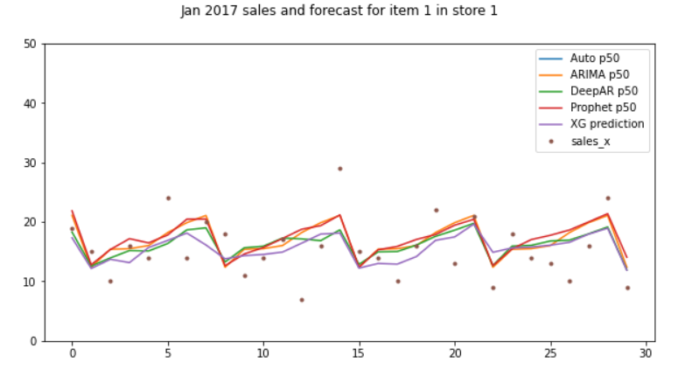
Compared multiple models to see variations – such as weekly variations
These are for just 1 product at 1 store

Slide 15
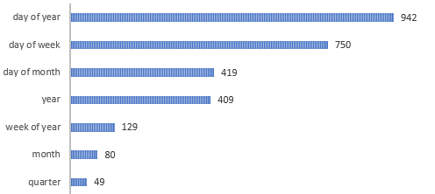
Know the importance of different features
Feature Importance

Slide 16
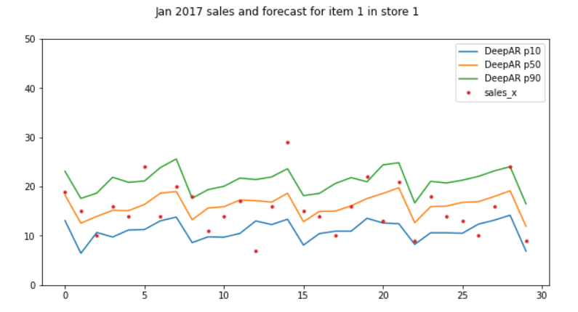
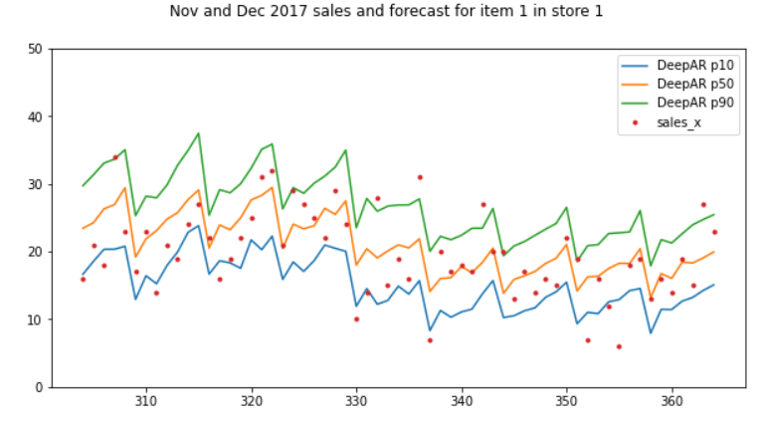
The forecasts confidence levels are still as good in December as they were for January
Jan 2017
Confidence intervals have not expanded out
Nov and Dec 2017
Top 90% range
Mid 50% range
Still picking up little dips and blips accurately
Picking up little dips and blips accurately
Bottom 10% range

Slide 17
For each model there are multiple metrics to potentially review
XG Boost for product / store over 365 days
Root Mean Squared Error (RMSE)
6.31
Grand Total
10,733,740 : actual sales
10,396,200 : forecast
3.1% : too low
5% of forecasts are within 0.92% of actual sales
75% of forecasts are within 17% of actual sales

Slide 18
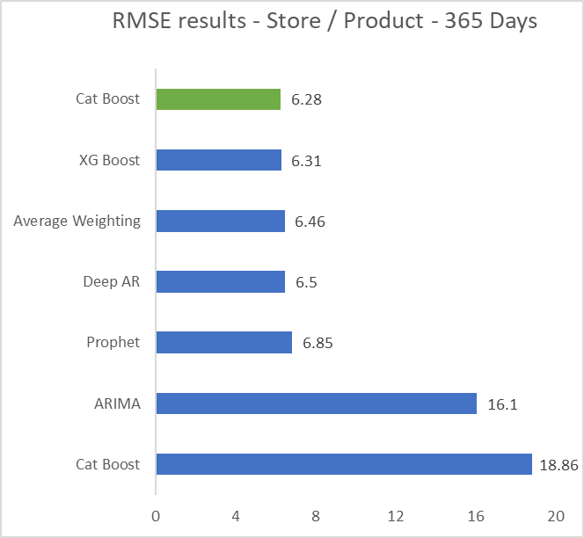
Cat Boost was the best tool for by store by product over 365 days (500 forecasts)
Best
Other
The lower the number the better

Slide 19
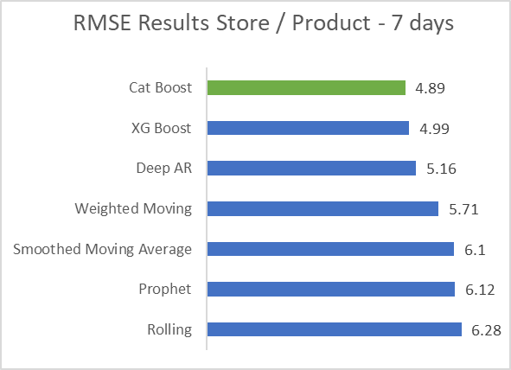
Cat Boost was also the best for the 7 day time series solution vs rolling forecasts variations.
Best
Other

Slide 20
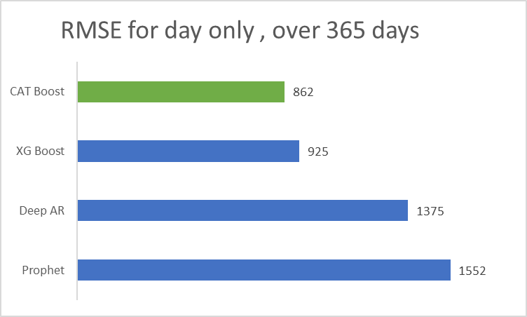
Cat Boost was the best tool for daily forecasts
Best
Other
There were also other forecasts that had bad results that were not shown

Slide 21
Can use the 1 forecast at store item and expand to other needs
by Item
by Store
by Store
by month – 12 months
by month – 12 months
50 forecasts over 12 months
50 forecasts over 12 months
Calculated Separately
68.9 XG Boost
Calculated Separately
3,138 XG Boost
Summed Daily to Monthly
Summed Daily to Monthly
70.4 Cat Boost
2,612 Cat Boost
71.6 XG Boost
Summed up from by Day to by Month without running separately
2,812 XG Boost
81.5 Deep AR
3,617 Prophet
84.6 Prophet
3,899 Deep AR

Slide 22
Seasonal ARIMA was the best for 1 forecast over 12 months
Best
OK

Slide 23
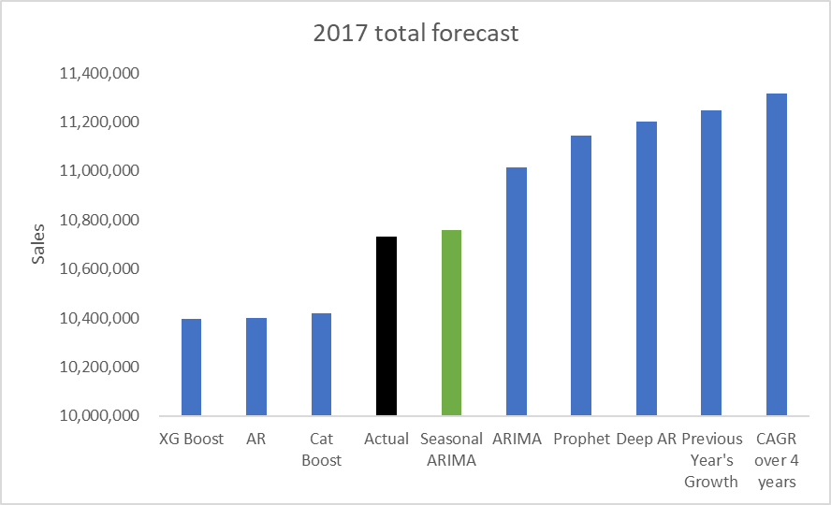
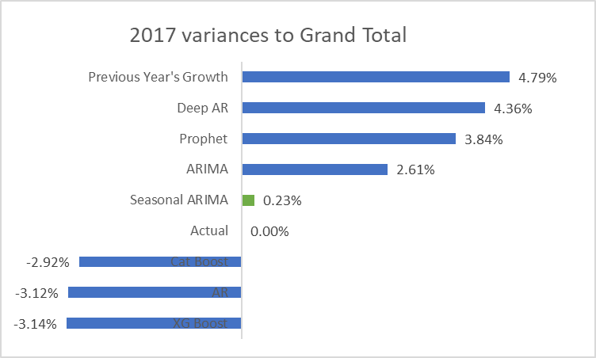
Seasonal ARIMA was the best forecast for the Grand Total
Cat Boost
AR
XG Boost
Started scale at 10M

Slide 24
Many time series algorithms were completed to meet multiple business needs
 | By | Period | How Many forecasts | Units per forecast | Total forecast numbers
By Item by Store | Day | 365 Days | 7 | 500 (10 stores X 50 products) | 1,227,500
By Item by Store | Day | 7 Days | 6 | 500 | 21000
By Day | Day | 365 days | 10 | 1 | 3,650
By Store | Month | 12 months | 4 | 10 | 480
By Item by Store | Month | 12 months | 4 | 500 | 2,000
By Month | Month | 12 months | 4 | 12 | 48
By Year | Year | 1 year | 10 | 1 | 10
TOTAL
21
1,304,688

Slide 25

Further Options

Slide 26
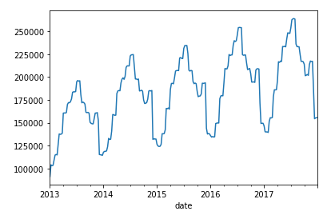
Can scale up and use across other situations
10 stores
1,000 stores
more stores
50 products
5,000 products
more products
Can forecast by Week
Train on less time
COVID impact is training will often need to be shortened / adjusted.
i.e. April 2021 seasonality for will be different to April 2020 seasonality
Forecast on more time
Trained on 4 years of data
Forecasted and measured on 1 year of data

Slide 27

Thanks
Background
Maths / statistics degree
Background in big data, strategy, analytics
Worked at Optus, Salmat, Reuters, Pathfinder Solutions
Alex Dance
Copy of This Presentation and code
https://github.com/alexdance2468/
Plus other data science projects completed
Contact Details
www.linkedin.com/in/alex-dance/
alexdance2468@gmail.com
0414 293 628

